Slide 1

Teaching Writing at Tweseldown

Slide 2

Aims of our Workshop
To know how we teach writing in class each day.
Expectations of Curriculum.
How you can help at home.

Slide 3
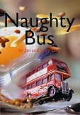




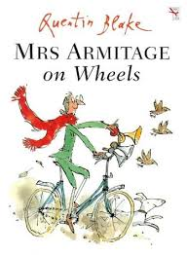
Inspirations of our Curriculum

Slide 4
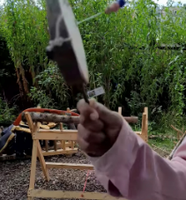
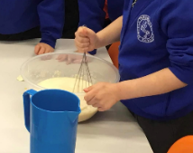
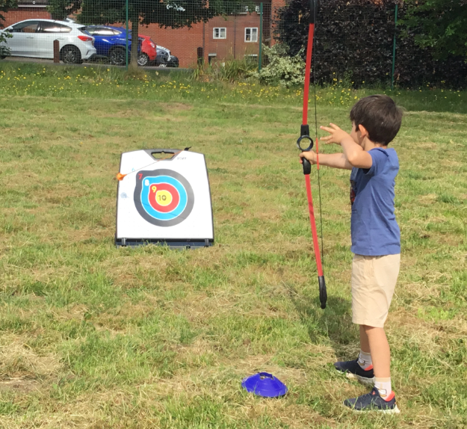
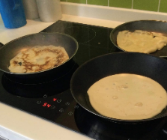
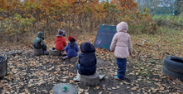
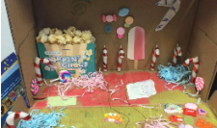
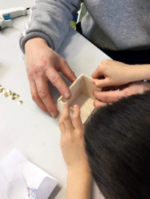
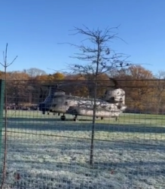
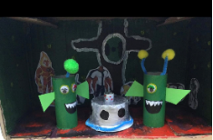
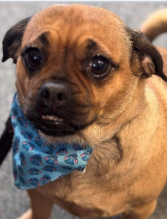
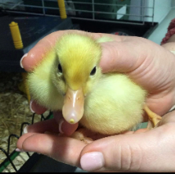
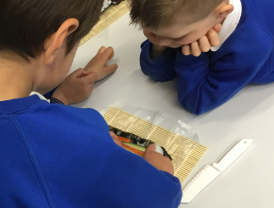
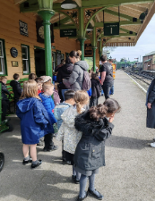
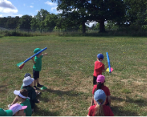
Inspirations of our Curriculum
Notes:
Trips – castle, Kensington, Local area walks, ropley station
Wellbeing week – ducks and dogs butterflies
Curriculum Week – sports, multi cultural
Story telling week, poetry day, WBD
Special events – chinook

Slide 5

Aims of our Curriculum
At Tweseldown, we believe that an inspiring English curriculum should develop children’s love of reading, writing and discussion. Within writing, we create enthusiastic and confident authors who understand the importance of writing as a key life skill for themselves. We expose the children to a variety of high quality texts and stimuli to inspire and engage their creativity. We provide the children with learning journeys that they are eager and excited about and ,which also provides, purposeful outcomes with a clear audience, with whom the children can share their writing with.

Slide 6
National Curriculum
Transcription – spelling and handwriting
Composition – articulating ideas and structuring them in speech and writing (this includes planning, drafting, writing, evaluating, proof-reading, editing and reading aloud their work)
Vocabulary, grammar and punctuation

Slide 7
EYFS
ELG: Fine Motor Skills Children at the expected level of development will:
Hold a pencil effectively in preparation for fluent writing – using the tripod grip in almost all cases.
Use a range of small tools, including scissors, paint brushes and cutlery.
Begin to show accuracy and care when drawing.
ELG: Writing Children at the expected level of development will:
Write recognisable letters, most of which are correctly formed.
Spell words by identifying sounds in them and representing the sounds with a letter or letters.
Write simple phrases and sentences that can be read by others.

Slide 8


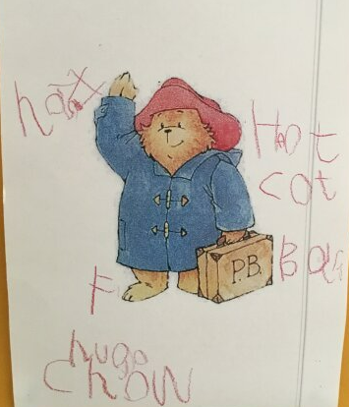
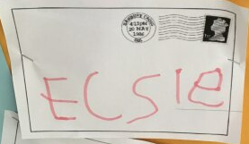
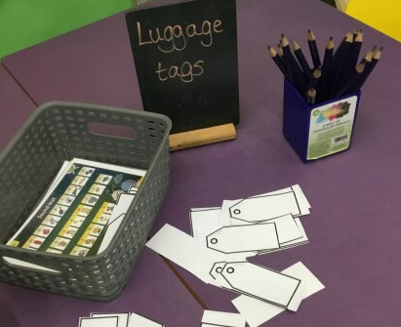
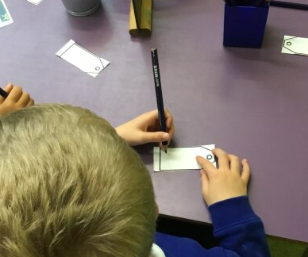
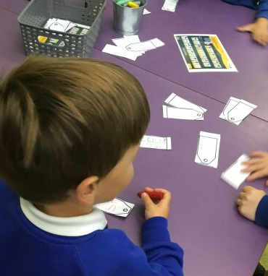
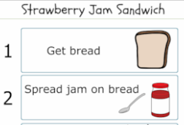
Year R Writing at Tweseldown
Phonics lesson daily
Writing area to support this learning
Finger Gym

Slide 9

4 Mini Moments
Vocabulary
Story
Joy of drawing and imagination
The children

Slide 10
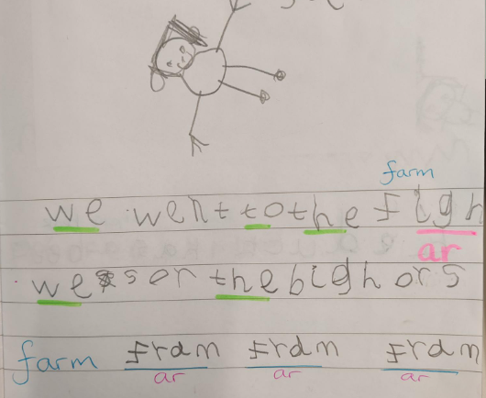
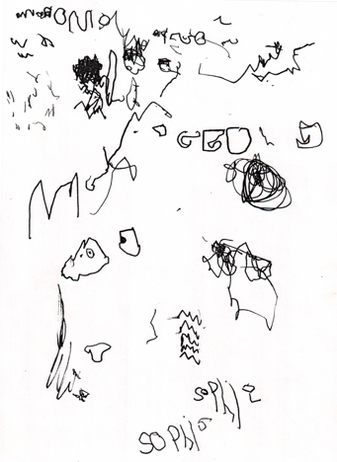
Year R Writing at Tweseldown
The child is writing recognisable letters and some and
knows that words should have spaces
between them.
The child knows that marks mean something, and has written their name.

Slide 11
Year 1
National Curriculum Breakdown
Transcription
Being able to form letters correctly and sit these on lines with appropriate spacing.
Composition
Being able to say out loud what they are writing about and being able to sequence these ideas.
Vocabulary, Grammar and Punctuation
Starting sentences with a capital letter and knowing when else these are needed. Ending sentences with a full stop, question mark and exclamation mark. Join sentences using 'and'.

Slide 12
KS1 writing at Tweseldown
Transition – Drawing Club
Unit of week over a 2 or 3 week period
End of unit outcome which is described to children at the start
Teachers set out objectives based on what children need to learn
45 minute lesson daily – chance for teaching, group work and independent activity

Slide 13

Year 1 learning journey at Tweseldown
Learn the story – verbal retell
Role Play
Vocabulary
Story Map
Rehearse a skill – use of full stop, use of capital for the pronoun ‘I’
Use of capitals for names
Planning and imitate
Complete own version of the story
Using skills learned
Modelled by teachers

Slide 14
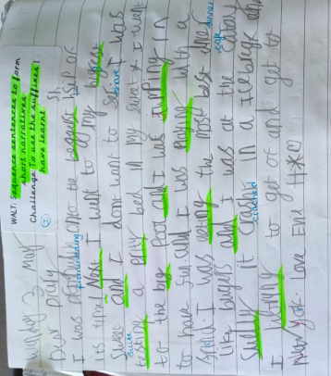
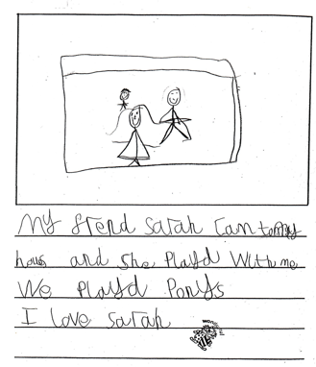
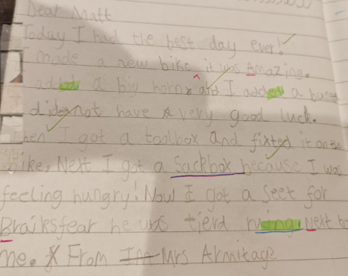
Year 1 writing at Tweseldown
The child can use letter blends, e.g. pl, sh, gr,
and the vowel sounds in the middle of words. Application of phonics learning, letter formation, finger spaces and use of capital to start and full stop to end the sentence.
Handwriting is legible and sat on the line.
Development of vocabulary.
Use of ‘and’ to join clauses.
Series of sentences.
Use of prefixes and suffixes.
Using 'and'
Development of vocabulary
Organisation of sentences.

Slide 15
Year 2
Develop positive attitudes towards and stamina for writing by:
Transcription
Spelling the majority of infant school (KS1) common exception words correctly and be able to apply rules when adding suffixes. Use known phonics knowledge to unknown words.
Handwriting is neat, legible, appropriately sized and children begin to join where appropriate.
Composition
Planning, rehearsing and writing stories and real life events and being able to share and discuss these ideas.
Begin to edit writing – check spellings, punctuation and grammar.
Reading my writing aloud.
Vocabulary, Grammar and Punctuation
Using paragraphs to organise writing and using a range of punctuation correctly including full stops, capital letters, exclamation marks, question marks, commas for lists and apostrophes.
Choose vocabulary to describe for the reader.
Begin to use a range of sentence types.

Slide 16
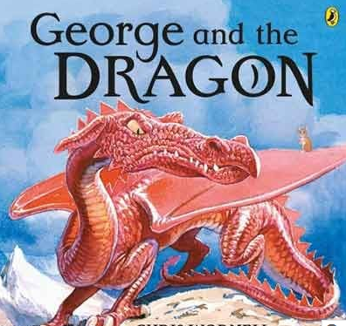
Year 2 learning journey at Tweseldown
Explore the text
Share outcome
Sequence story
Role play story
Create own characters.
Practise writing noun phrases to describe.
Planning own ideas for story.
Write own story using characters created.
Teachers to model ideas to children and specific skills.
Children to edit and re-draft writing.

Slide 17
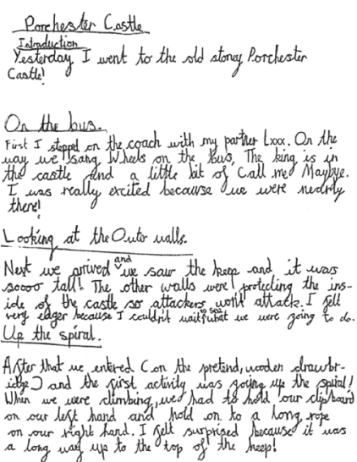
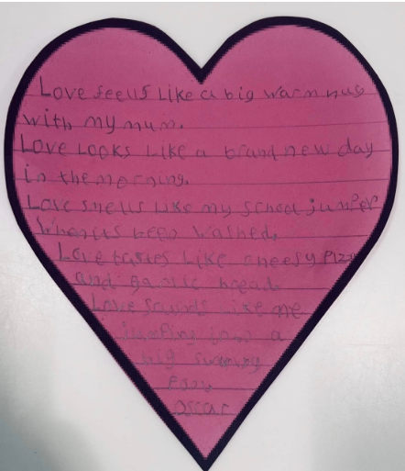
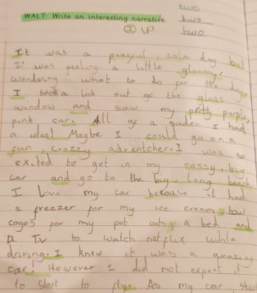
Year 2
Writing at Tweseldown
Writer’s voice
Commas for list
Use of !
Use of co-ordinates
Understanding of layout features
Use of time adverbials
Paragraphing
Range of punctuation
Use of subordination

Slide 18
How can I help at home?
Freedom to write.
Reading with your children.
If you can’t speak it, you can’t write it!
Don’t be scared of vocabulary.
Sentence punctuation.
Homework.

Slide 19
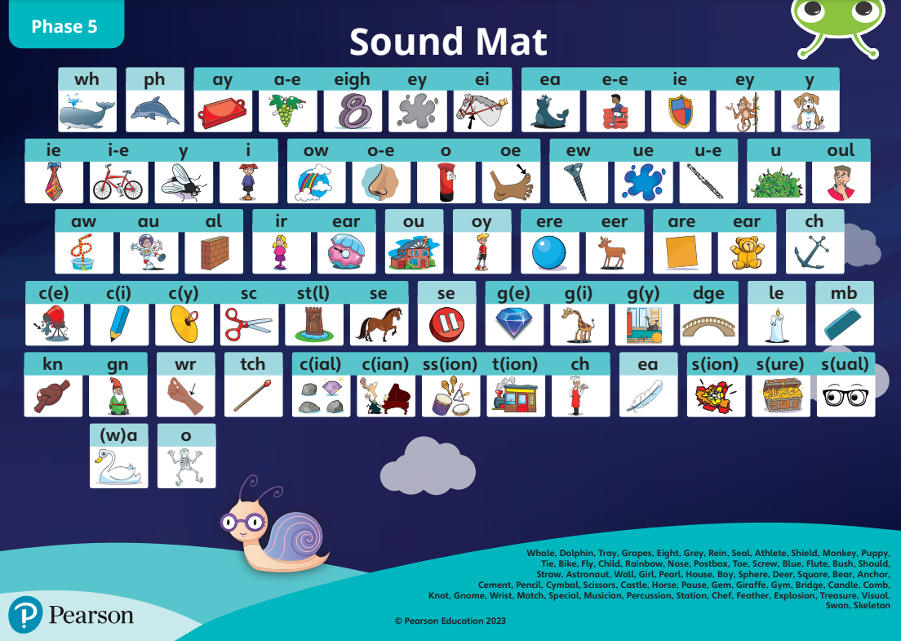
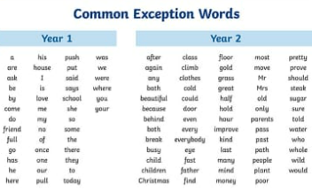
How can I help at home?

Slide 20
Questions…

